Slide 1
Java Script to jQuery

Slide 2


www.zyxware.com
29th September 2012

Slide 3
An Introduction to
Java Script

Slide 4
What is JS, What isn't JS
JS is a dynamic, weakly typed, prototype based scripting language.
Now Java Script is an implementation of ECMAScript
Most Java Script implementations are part of web browsers
Java Script is not Java

Slide 5
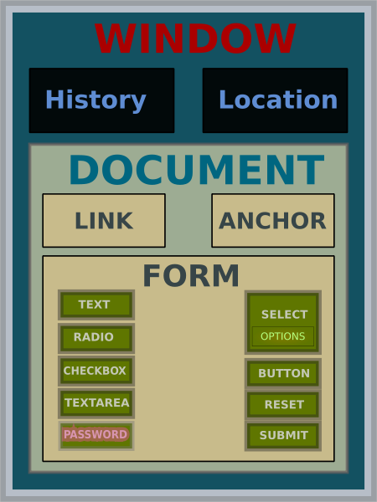
DOM – Document Object Model
Document Object Model is the way JavaScript sees the browser state and the HTML page it contains

Slide 6
Firebug - Demonstration
Firebug extention to Firefox.

Slide 7
Java Script Syntax
Case Sensitive
Whitespaces and semicolons
  Semicolon insertion
Example:
return
a + b;
// Returns undefined. Treated as:
// return;
// a + b;
but
a = b + c
(d + e).foo()
// Treated as:
// a = b + c(d + e).foo();

Slide 8
Java Script Syntax (Variables)
Variables
    No types
    Decleared with var
Example:
var x = 0; // A global variable, because it is not in any function
function f() {
var z = 'foxes', r = 'birds'; // 2 local variables
m = 'fish'; // global because it wasn't declared anywhere before
function child() {
var r = 'monkeys'; // This variable is local and does not affect the "birds" r of the parent function.
z = 'penguins'; // The child function is able to access the variables of the parent function, this is called closure.
}
twenty = 20; // This variable is declared on the next line, but usable anywhere in the function, even before, as here
var twenty;
child();
return x; // We can use x here because it is global
}
f();
alert(z); // This line will raise a ReferenceError exception because the value of z is no longer available

Slide 9
Java Script Syntax (data types)
  Primitive data types
    Undefined
    Null
    Number
    String
    Boolean
Example:

Slide 10
Java Script Syntax (native objects)
  Native objects
    Array
    Math
    Date
    Regular expression
    Error
    Function
Example:

Slide 11
Java Script Syntax (operators)
  Operators
    Arithmetic + - * / % ++ --
    Assignment = += -= *= /= %=
    Comparison == != > >= < <= === !==
    Logical ! || && ?:
    Bitiwise & | ^ << >> ~
    String = + +=
Example:

Slide 12
Java Script Syntax (control structures)
  Control Structures
    If else
    switch
    for loop
    for in loop
    while
    do while
    with
Example:

Slide 13
Java Script Syntax (functions)
  Functions
  function gcd(segmentA, segmentB) {
  var diff = segmentA - segmentB;
  if (diff == 0)
  return segmentA;
  return diff > 0 ? gcd(segmentB, diff) : gcd(segmentA, -diff);
  }
  alert(gcd(60, 40)); // 20
  var mygcd=gcd; // mygcd is a reference to the same function as gcd. Note no argument ()s.
  alert(mygcd(60, 40)); // 20

Slide 14
Java Script Syntax (objects)
  Objects
  // Constructor
  var anObject = new Object();
  // Object literal
  var objectA = {};
  var objectA2 = {}; // A != A2, {}s create new objects as copies.
  var objectB = {index1: 'value 1', index2: 'value 2'};

Slide 15
Java Script Syntax (error handling)
  Exception Handling
    Try Catch Finally
    try {
    // Statements in which exceptions might be thrown
    } catch(errorValue) {
    // Statements that execute in the event of an exception
    } finally {
    // Statements that execute afterward either way
    }

Slide 16
Problems with Java Script
  Different browsers handle dom differently
  http://www.quirksmode.org/compatibility.html
    Example
    var addEvent = function(el, evt, fn) {
    if (el.addEventListener) {
    el.addEventListener(evt, fn, false);
    } else if (el.attachEvent) {
    el.attachEvent('on' + evt, fn);
    }
    };

Slide 17
An Introduction to
jQuery

Slide 18
Introduction to jQuery
    DOM element selections
    DOM traversal and modification (including support for CSS 1-3)
    DOM manipulation based on CSS selectors that uses node elements name and node elements attributes (id and class) as criteria to build selectors
    Events
    Effects and animations
    AJAX
    Extensibility through plug-ins
    Utilities - such as user agent information, feature detection
    Compatibility methods that are natively available in modern browsers but need fall backs for older ones - For example the inArray() and each() functions.
    Multi-browser (not to be confused with cross-browser) support.

Slide 19
Including the library
    <script type="text/javascript" src="jquery.js"></script>
    The most popular and basic way to introduce a jQuery function is to use the .ready() function.
    $(document).ready(function() {
    // script goes here
    });
    or the shortcut
    $(function() {
    // script goes here
    });

Slide 20
Selectors
    Select any elements...
    $('a')
    $(document)

Slide 21
Effects
    $(a).hide("slow");

Slide 22
Events
    $('h1').click(function() {
    $(this).hide();
    });

Slide 23
Manipulation
    $('h2').addClass('hello');

Slide 24
Traversing
    Childern()
    each()
    Parent()
    not()

Slide 25
Extending jQuery through pluggins
    (function( $ ) {
    $.fn.myPlugin = function() {
    // Do your awesome plugin stuff here
    };
    })( jQuery );

Slide 26
Thank You!
Vimal Joseph vimal.joseph@zyxware.com

Slide 27

Zyxware Technologies
3/2457(6), TKD Road, Marappalam
Pattom P. O., Trivandrum, Kerala - 695004, India
Tel: 0471-4063818(O), +91-9446-06-9446 (M) info@zyxware.com

